Slide 1
A Taxonomy of Communication Networks
Qiao Xiang
https://qiaoxiang.me/courses/cnns-xmuf21/index.shtml
09/16/2021
This deck of slides are heavily based on CPSC 433/533 at Yale University, by courtesy of Dr. Y. Richard Yang.

Slide 2
Outline
Admin. and recap
A brief introduction to the Internet:
present
Challenges of Internet networks and apps
A taxonomy of communication networks

Slide 3
Admin.
If you haven't filled out the survey, please go to the class website to do so

Slide 4
Recap
A protocol defines the format and the order of messages exchanged between two or more communicating entities, as well as the actions taken on the transmission or receipt of a message or other events.
Key Internet milestones and their implications:
ARPANET is sponsored by ARPA →
The initial IMPs (routers) were made by a small company →
Many networks →
Commercialization →
design should survive failures
keep the network simple
internetworking: need a network to connect networks
architecture supporting decentralized, autonomous systems

Slide 5
Outline
Admin. and recaps
A brief introduction to the Internet
past
present

Slide 6
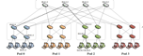
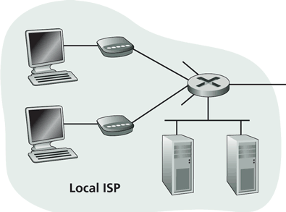
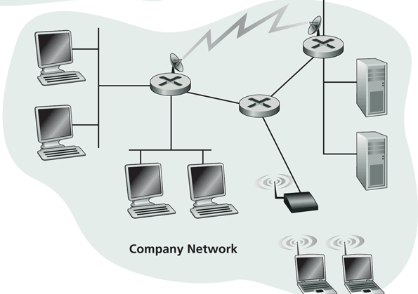
Internet Physical Infrastructure
Residential access
Cable, Fiber, DSL, Wireless
ISP
Backbone ISP
ISP
The Internet is a network of networks
Each individually administrated network is called an Autonomous System (AS)
data center
Campus access, e.g.,
Ethernet
Wireless

Slide 7
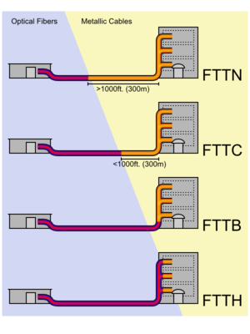
Access: Fiber to the x
http://en.wikipedia.org/wiki/Fiber_to_the_x
Notes:
the common form of gigabit Ethernet (1Gbit/s) runs over relatively economical category 5e, category 6, or augmented category 6 unshielded twisted-pair copper cabling but only to 300 ft (91 m). However, 1Gbit/s ethernet over fiber can easily reach tens of miles.

Slide 8
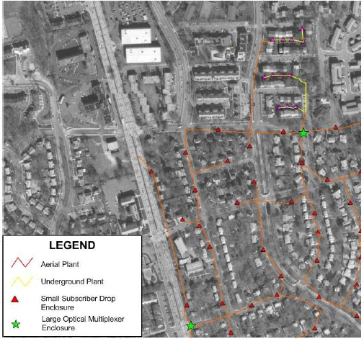
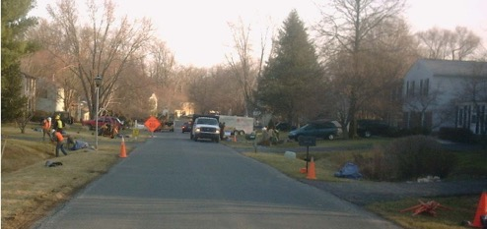
Access: Fiber to the Premises (FTTP)
Deployed by Verizon, AT&T, Google，
One of the largest comm. construction projects
Notes:
Average US:
down: 5.8 MBps
Up: 1.2 Mbps
Google fiber:
Cost: $300/customer
http://en.wikipedia.org/wiki/Fiber_to_the_x
http://www.telecompetitor.com/google-ftth-invades-texas-with-austin-the-next-stop-for-google-fiber/
http://www.youtube.com/watch?v=6uZVqPuq81c

Slide 9
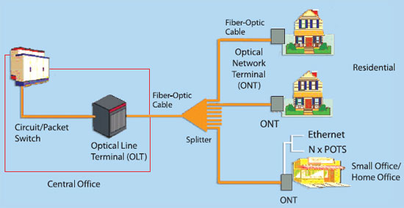
FTTP Architecture
Notes:
http://en.wikipedia.org/wiki/Fiber_to_the_x

Slide 10
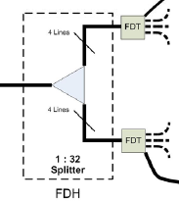
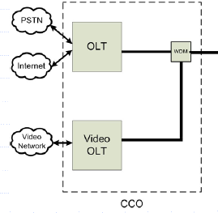
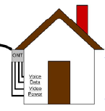
FTTP Architecture
Optical Network Terminal (ONT) box outside dwelling or business
Fiber Distribution Terminal (FDT) in poles or pedestals
Fiber Distribution Hub (FDH) at street cabinet
Optical Line Terminal (OLT) at central office

Slide 11
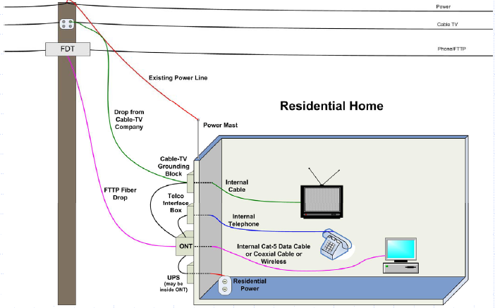
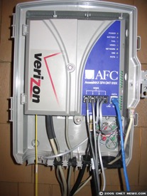
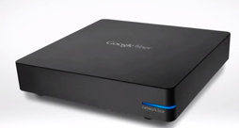
FTTP Architecture: To Home

Slide 12
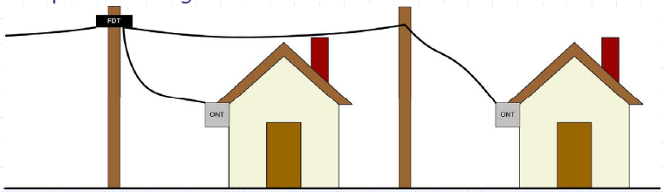
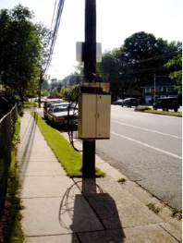
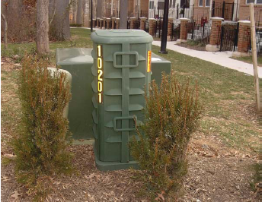
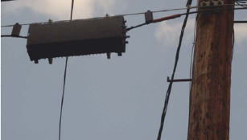
FTTP Architecture: Fiber Distribution Terminal (FDT)

Slide 13
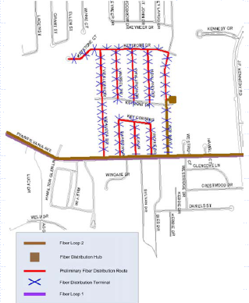
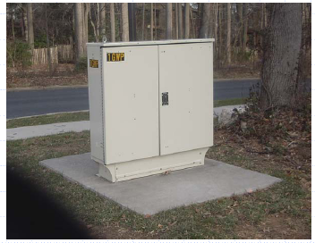
FTTP Architecture: Central to Fiber Distribution Hub (FDH)
- Backbone fiber ring on
primary arterial streets
(brown)
- Local distribution fiber
plant (red) meets backbone
at cabinet
FDH

Slide 14
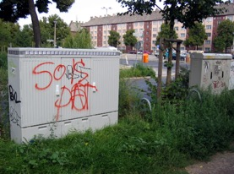
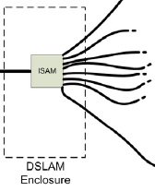
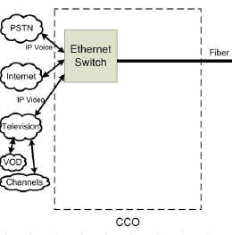
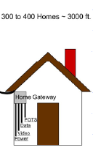
Access: DSL
Compared with FTTP, copper from cabinet (DSLAM) to home
DSLAM

Slide 15

Access: Wireless
https://x.company/loon/

Slide 16
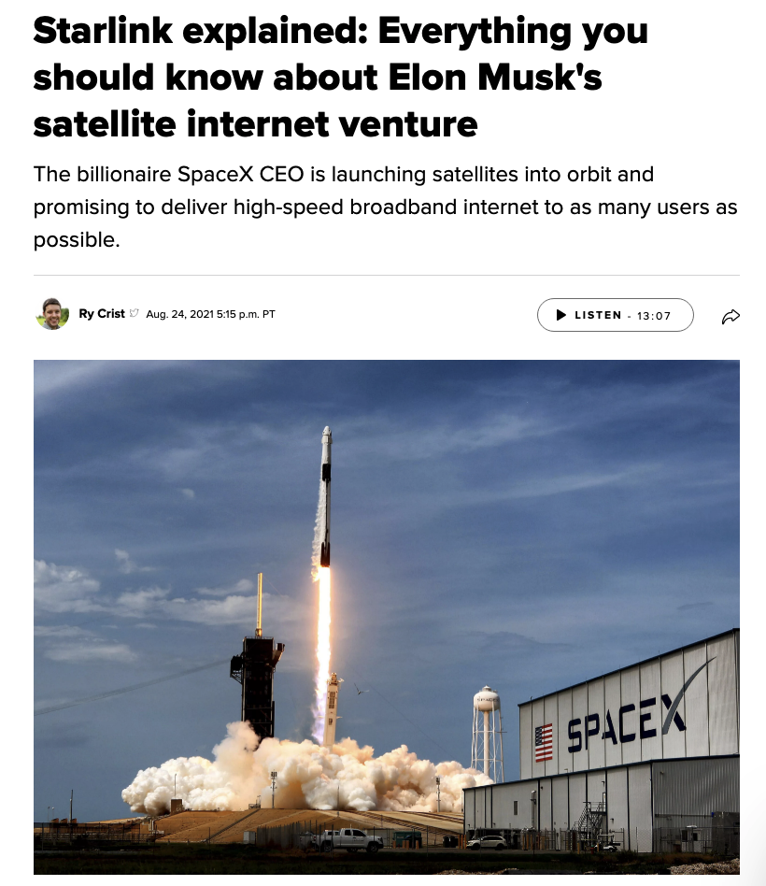
Access: Wireless
https://www.cnet.com/home/internet/starlink-satellite-internet-explained/

Slide 17

Campus Network
Internet
CE
F2
F1 (Firewall)
R1
S2
S1
LB2
LB1 (Load balancer)
IPS3
IPS2
IPS1 (Intrusion prevention)
S6
S5
S4
S3
tier-1
VLAN 200
VLAN 100
VLAN 300
VLAN 400
Logger
Tier-3
Tier-2
Tier-1

Slide 18
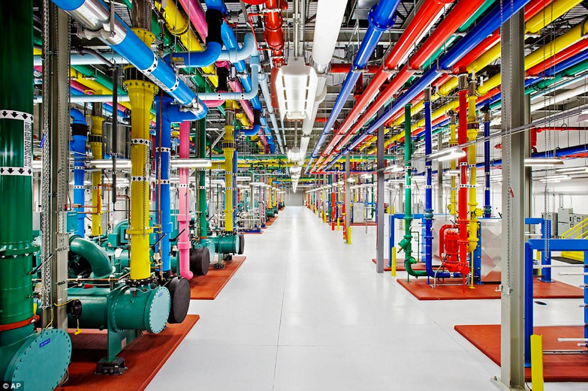
Data Center Networks
http://www.dailymail.co.uk/sciencetech/article-3369491/Google-s-plan-world-Search-engine-build-half-billion-dollar-data-center-US.html

Slide 19
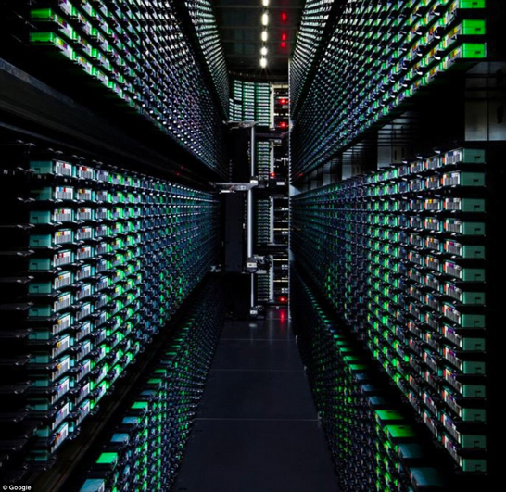
Data Center Networks
http://www.dailymail.co.uk/sciencetech/article-3369491/Google-s-plan-world-Search-engine-build-half-billion-dollar-data-center-US.html
Notes:
http://www.cse.wustl.edu/~jain/cse570-13/ftp/m_03dct.pdf

Slide 20
Foundation of Data Center Networks
1
2
n
1
2
n

Slide 21
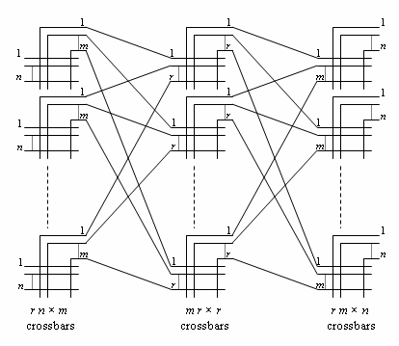
Foundation of Data Center Networks: Clos Networks
Q: How big is m so that each new call can be established w/o moving current calls?
Challenge to the class: If you can move existing calls, it is only m >= n.
https://en.wikipedia.org/wiki/Clos_network
Notes:
Strict-sense nonblocking Clos networks (m ≥ 2n−1): the original 1953 Clos result[edit]
If m ≥ 2n−1, the Clos network is strict-sense nonblocking, meaning that an unused input on an ingress switch can always be connected to an unused output on an egress switch, without having to re-arrange existing calls. This is the result which formed the basis of Clos's classic 1953 paper. Assume that there is a free terminal on the input of an ingress switch, and this has to be connected to a free terminal on a particular egress switch. In the worst case, n−1 other calls are active on the ingress switch in question, and n−1 other calls are active on the egress switch in question. Assume, also in the worst case, that each of these calls passes through a different middle-stage switch. Hence in the worst case, 2n−2 of the middle stage switches are unable to carry the new call. Therefore, to ensure strict-sense nonblocking operation, another middle stage switch is required, making a total of 2n−1.
If m ≥ n, the Clos network is rearrangeably nonblocking, meaning that an unused input on an ingress switch can always be connected to an unused output on an egress switch, but for this to take place, existing calls may have to be rearranged by assigning them to different centre stage switches in the Clos network.^{[3]} To prove this, it is sufficient to consider m = n, with the Clos network fully utilised; that is, r×n calls in progress. The proof shows how any permutation of these r×n input terminals onto r×n output terminals may be broken down into smaller permutations which may each be implemented by the individual crossbar switches in a Clos network with m = n.
The proof uses Hall's marriage theorem^{[4]} which is given this name because it is often explained as follows. Suppose there are r boys and r girls. The theorem states that if every subset of k boys (for each k such that 0 ≤ k ≤ r) between them know k or more girls, then each boy can be paired off with a girl that he knows. It is obvious that this is a necessary condition for pairing to take place; what is surprising is that it is sufficient.
In the context of a Clos network, each boy represents an ingress switch, and each girl represents an egress switch. A boy is said to know a girl if the corresponding ingress and egress switches carry the same call. Each set of k boys must know at least k girls because k ingress switches are carrying k×n calls and these cannot be carried by less than k egress switches. Hence each ingress switch can be paired off with an egress switch that carries the same call, via a one-to-one mapping. These r calls can be carried by one middle-stage switch. If this middle-stage switch is now removed from the Clos network, m is reduced by 1, and we are left with a smaller Clos network. The process then repeats itself until m = 1, and every call is assigned to a middle-stage switch.

Slide 22
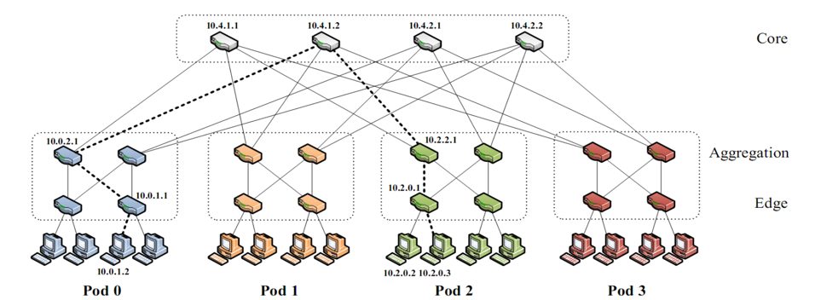
Data Center Networks: Fat-tree Networks
K-ary fat tree: three-layer topology (edge, aggregation and core)
k pods w/ each pod consists of (k/2)² servers & 2 layers of k/2 k-port switches
each edge switch connects to k/2 servers & k/2 aggr. switches
each aggr. switch connects to k/2 edge & k/2 core switches
(k/2)² core switches: each connects to k pods
Q: How large a network can k-ary support using k-port switches?
http://www.cs.cornell.edu/courses/cs5413/2014fa/lectures/08-fattree.pdf
Notes:
K^3/4
http://www.fiber-optic-tutorial.com/100g-switch-price-and-configuration.html
http://web.stanford.edu/class/ee384y/Handouts/clos_networks.pdf
https://en.wikipedia.org/wiki/Clos_network

Slide 23
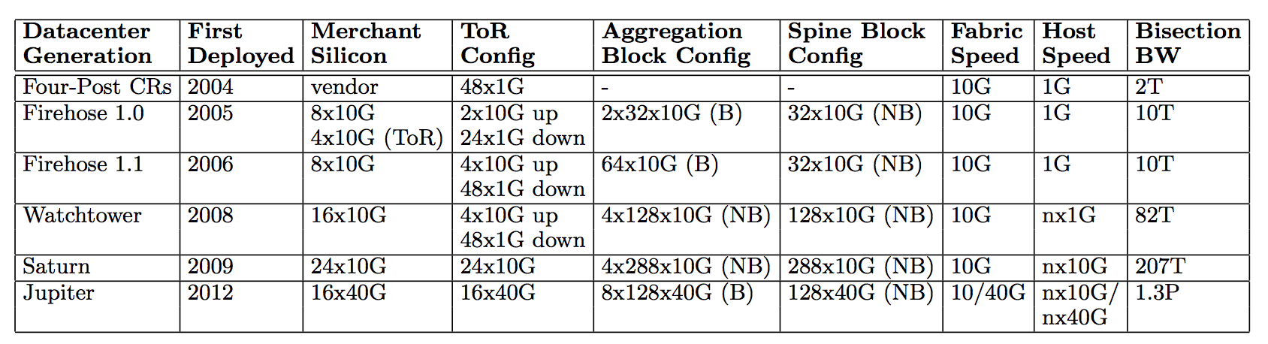
Data Center Networks
For example, Google Jupiter at 1 Pbits/sec bisection bw: 100,000 servers at 10G each
http://googlecloudplatform.blogspot.com/2015/06/A-Look-Inside-Googles-Data-Center-Networks.html
http://conferences.sigcomm.org/sigcomm/2015/pdf/papers/p183.pdf
Notes:
http://web.stanford.edu/class/ee384y/Handouts/clos_networks.pdf
https://en.wikipedia.org/wiki/Clos_network

Slide 24
Recall: Internet Physical Infrastructure
Residential access, e.g.,
Cable, Fiber, DSL, Wireless
ISP
Backbone ISP
ISP
The Internet is a network of networks
Each individually administrated network is called an Autonomous System (AS)
data center
Campus access, e.g.,
Ethernet, Wireless

Slide 25
Yale Internet Connection
traceroute www.tsinghua.edu.cn
1 college.net.yale.internal (172.28.201.65) 1.440 ms 1.227 ms 1.453 ms
2 10.1.1.13 (10.1.1.13) 1.359 ms 1.153 ms 1.173 ms 3 level3-10g-asr.net.yale.internal (10.1.4.40) 2.786 ms 6.110 ms 2.547 ms 4 cen-10g-yale.net.yale.internal (10.1.3.102) 2.646 ms 3.242 ms 2.576 ms 5 * * * 6 enrt064hhh-9k-te0-3-0-5.net.cen.ct.gov (67.218.83.254) 5.169 ms 3.797 ms 6.891 ms 7 198.71.46.215 (198.71.46.215) 3.615 ms 3.742 ms 3.931 ms 8 et-10-0-0.1180.rtsw.newy32aoa.net.internet2.edu (198.71.46.214) 6.661 ms 6.532 ms 6.310 ms 9 et-4-0-0.4079.sdn-sw.phil.net.internet2.edu (162.252.70.103) 8.658 ms 8.714 ms 8.666 ms 10 et-1-1-0.4079.rtsw.wash.net.internet2.edu (162.252.70.119) 11.787 ms 30.111 ms 11.900 ms 11 et-8-1-0.4079.sdn-sw.ashb.net.internet2.edu (162.252.70.62) 12.428 ms 16.654 ms 15.862 ms 12 et-7-1-0.4079.rtsw.chic.net.internet2.edu (162.252.70.61) 28.898 ms 28.999 ms 28.908 ms 13 et-3-1-0.4070.rtsw.kans.net.internet2.edu (198.71.47.207) 40.084 ms 39.958 ms 39.695 ms 14 et-8-0-0.4079.sdn-sw.denv.net.internet2.edu (162.252.70.10) 50.195 ms 50.562 ms 50.258 ms 15 et-4-1-0.4079.rtsw.salt.net.internet2.edu (162.252.70.9) 59.707 ms 60.261 ms 59.762 ms 16 et-7-0-0.4079.sdn-sw.lasv.net.internet2.edu (162.252.70.30) 67.555 ms 67.539 ms 67.312 ms 17 et-4-1-0.4079.rtsw.losa.net.internet2.edu (162.252.70.29) 72.419 ms 72.428 ms 72.376 ms ...

Slide 26
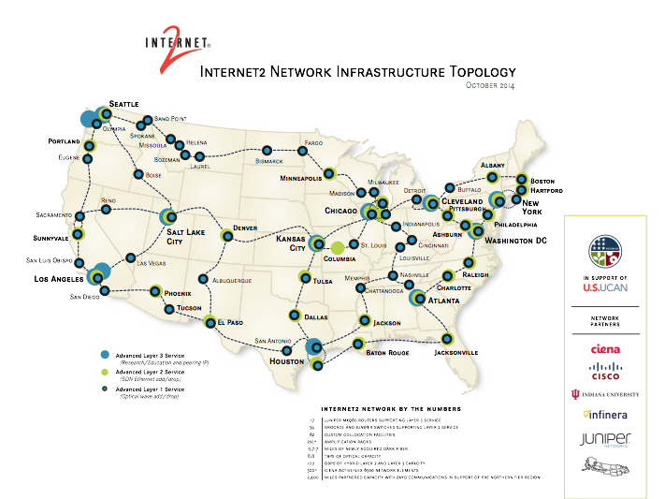
Internet2
\
http://noc.net.internet2.edu/i2network/maps-documentation/maps.html#Internet2 Combined Infrastructure Network Map

Slide 27
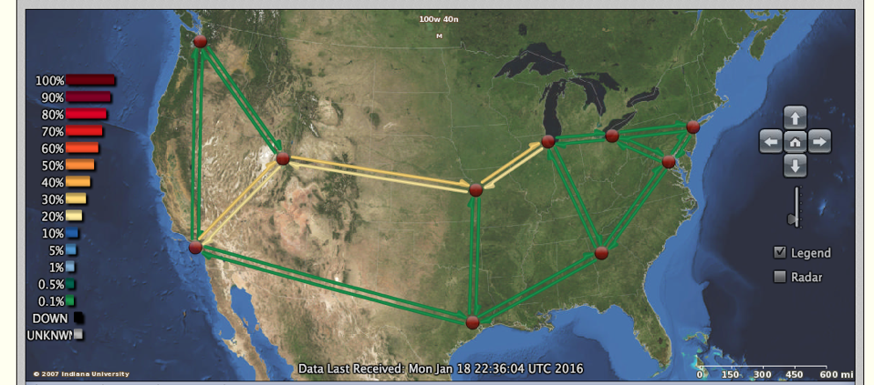
Internet2
http://atlas.grnoc.iu.edu/atlas.cgi?map_name=Internet2%20IP%20Layer

Slide 28
XMU Internet Connection
Try traceroute from XMU to
www.microsoft.com
www.baidu.com
www.sina.com.cn
www.taobao.com

Slide 29
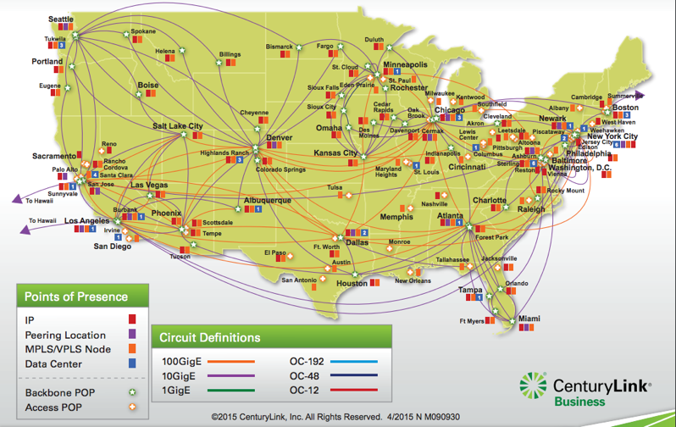
Qwest Backbone Map
Qwest (CentryLink) Network Maps
http://www.centurylink.com/business/asset/network-map/ip-mpls-network-nm090930.pdf
http://www.centurylink.com/business/resource-center/network-maps/

Slide 30
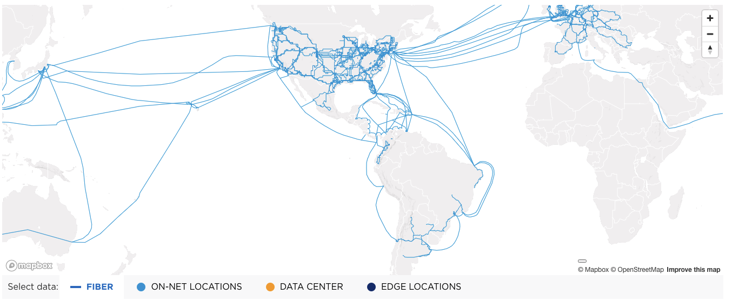
Level3 (now part of LUMEN) Network Map
https://www.lumen.com/en-us/resources/network-maps.html

Slide 31
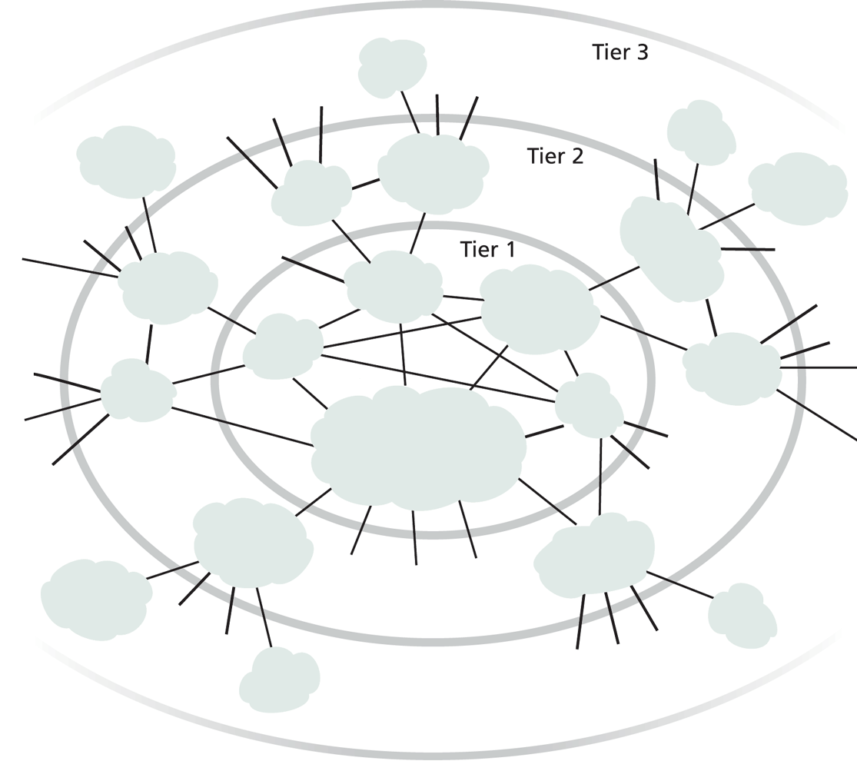
Internet ISP Connectivity
Roughly hierarchical
Divided into tiers
Tier-1 ISPs are also called backbone providers, e.g., AT&T, Verizon, Sprint, Level 3, Qwest
An ISP runs (private) Points of Presence (PoP) where its customers and other ISPs connect to it
ISPs also connect at (public) Internet Exchange Point (IXP)
public peering
http://en.wikipedia.org/wiki/List_of_Internet_exchange_points_by_size

Slide 32
Outline
Admin. and recaps
A brief introduction to the Internet
past
present
topology
traffic

Slide 33
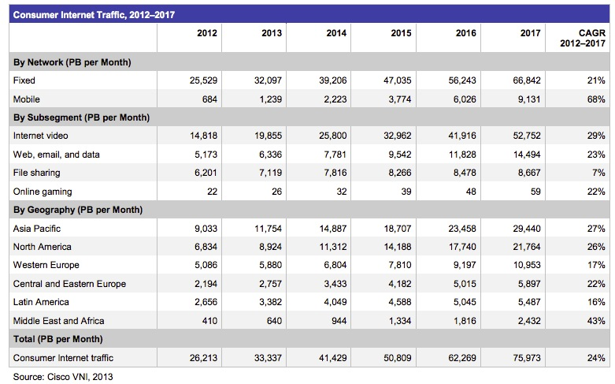
Internet (Consumer) Traffic
Notes:
http://www.cisco.com/en/US/solutions/collateral/ns341/ns525/ns537/ns705/ns827/white_paper_c11-481360.pdf

Slide 34
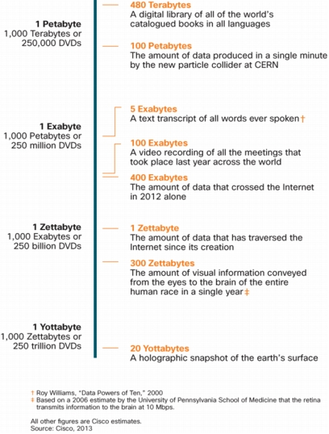

Internet Traffic in Perspective
640K ought to be enough for anybody.

Slide 35
Outline
Admin. and recaps
A brief introduction to the Internet: past and present
Challenges of Internet networks and apps

Slide 36

Scale
“Developers who have worked at the small scale might be asking themselves why we need to bother when we could just use some kind of out-of the-box solution. For small-scale applications, this can be a great idea. We save time and money up front and get a working and serviceable application. The problem comes at larger scales—there are no off-the-shelf kits that will allow you to build something like Amazon... There’s a good reason why the largest applications on the Internet are all bespoke creations: no other approach can create massively scalable applications within a reasonable budget.”
http://www.evontech.com/symbian/55.html

Slide 37
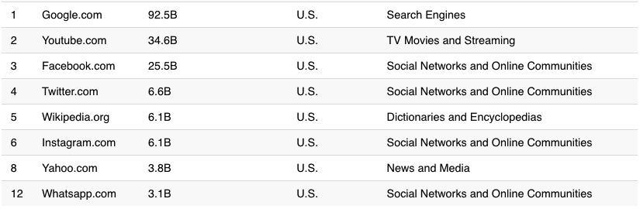
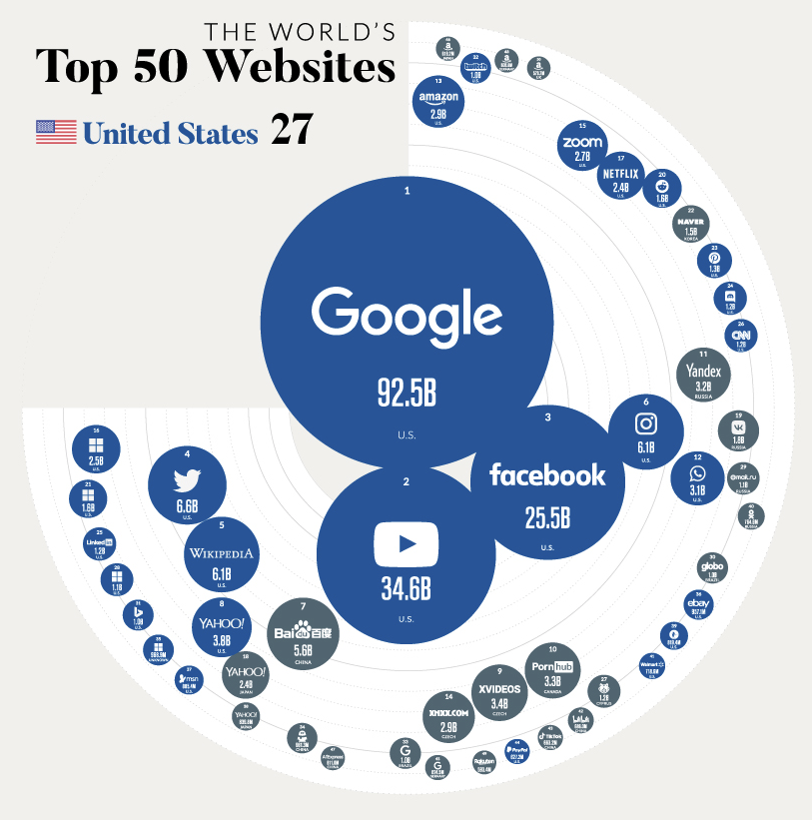
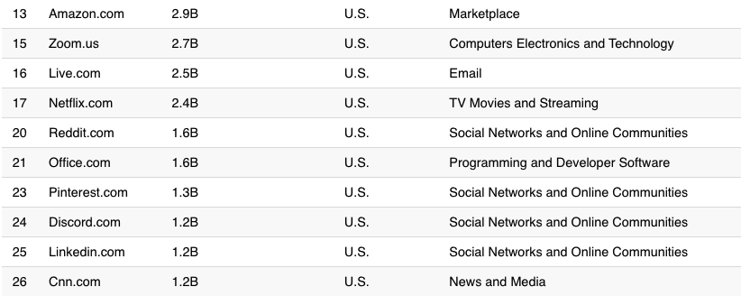
Largest Internet Sites in the World
https://www.visualcapitalist.com/wp-content/uploads/2021/01/Country-With-the-Most-Websites.html
Notes:
http://www.comscore.com/Insights/Press_Releases/2013/8/comScore_Media_Metrix_Ranks_Top_50_U.S._Web_Properties_for_July_2013

Slide 38
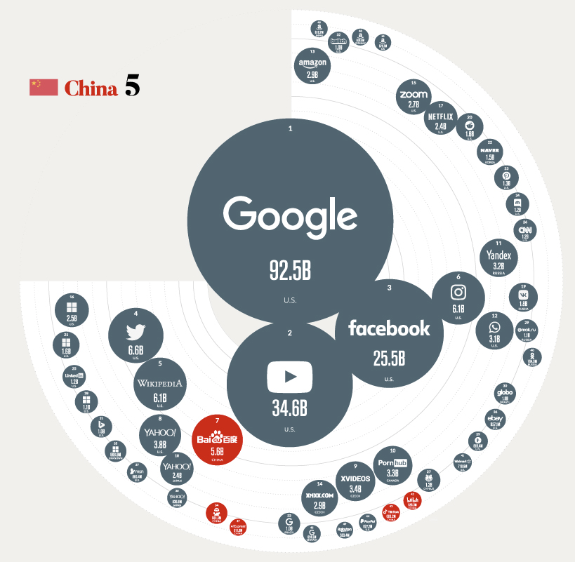
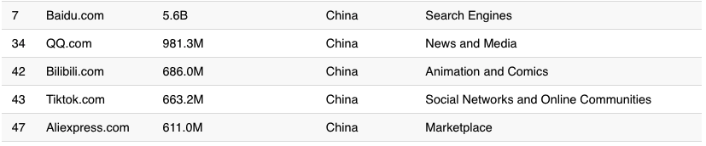
Largest Internet Sites in the World
https://www.visualcapitalist.com/the-50-most-visited-websites-in-the-world/

Slide 39
General Complexity
Complexity in highly organized systems arises primarily from design strategies intended to create robustness to uncertainty in their environments and component parts.
Scalability is robustness to changes to the size and complexity of a system as a whole.
Evolvability is robustness of lineages to large changes on various (usually long) time scales.
Reliability is robustness to component failures.
Efficiency is robustness to resource scarcity.
Modularity is robustness to component rearrangements.
David Meyer

Slide 40
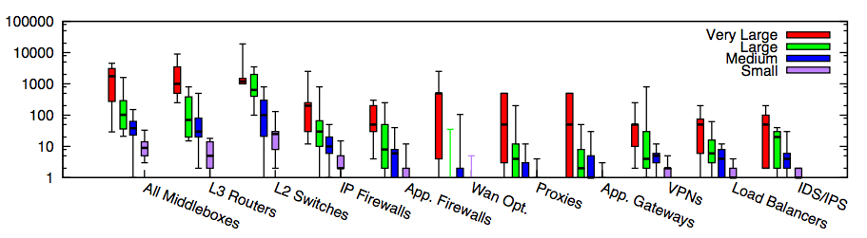
Core: Simple Forwarding to Network Functions
Modern networks contain diverse types of equipment beyond simple routing/forwarding
Enterprise networks
Small: <=1k hosts; Medium: 1k-10k; Large: 10k-100k; Very Large: >= 100k
Source: [Sherry, et. al SIGCOMM’12]

Slide 41

Centralized vs Decentralized (Price of Anarchy)
Autonomous (“Selfish”) App: Assume each link has a latency function l_{e}(x): latency of link e when x amount of traffic goes through e:
l(x) = x
total traffic
s
t
l(x) = 1

Slide 42
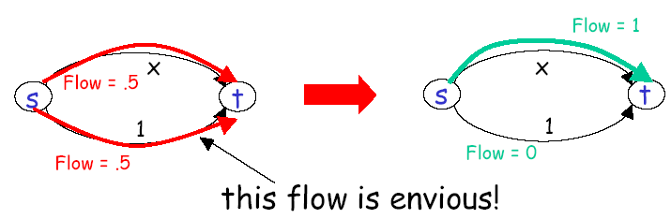
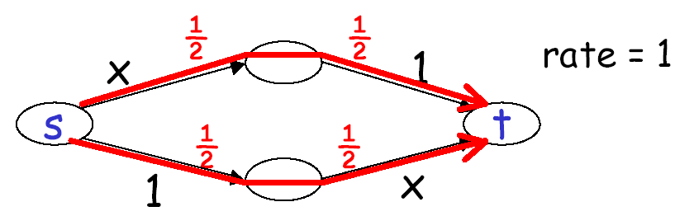
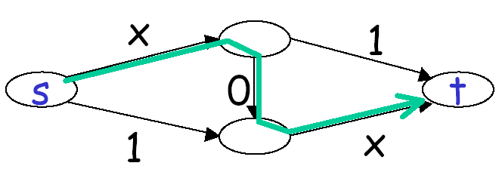
Autonomous (“Selfish”) App
Braess’s paradox
Notes:
Every increase of 20 ms in latency leads to 1% drop in click-through rate
E-commerce abandonment zone:
33% users will abandon a site takes longer than 4 sec [Jupiter]

Slide 43
Decentralized (“Selfish”) Users
preferred
2 0
2 3 0
2
4
less
preferred
0
3 1 0
3 0
1 2 0
1 0
1
3
3

Slide 44
Decentralized (“Selfish”) Users
preferred
2 3 0
2 0
2
4
less
preferred
0
3 1 0
3 0
1 2 0
1 0
1
3
3

Slide 45

Distributed vs Centralized
Distributed computing is hard, e.g.,
FLP Impossibility Theorem
Arrow’s Impossibility Theorem
Achieved good design for only few specific tasks (e.g., state distribution, leader election). Hence, a trend in networking is Software Defined Networking, which is a way of moving away from generic distributed computing, by focusing on utilizing the few well-understood primitives, in particular logically centralized state.

Slide 46

Recall: Internet Physical Infrastructure
Residential access, e.g.,
Cable, Fiber, DSL, Wireless
ISP
Backbone ISP
ISP
The Internet is a network of networks
Each individually administrated network is called an Autonomous System (AS)
~ 58000 ASes; Avg 5.7 hops; (http://bgp.potaroo.net/as2.0/bgp-active.html)
data center
Campus access, e.g.,
Ethernet, Wireless

Slide 47
Roadmap
So far we have looked at only the topology and physical connectivity of the Internet: a mesh of computers interconnected via various physical media
A basic question: how are data (the bits) transferred through communication networks?

Slide 48
Outline
Admin. and recaps
A brief introduction to the Internet: past and present
Challenges of Internet networks and apps
A taxonomy of communication networks

Slide 49
Taxonomy of Communication Networks
communication networks
switched networks
broadcast networks
Broadcast networks
nodes share a common channel; information transmitted by a node is received by all other nodes in the network
examples: TV, radio
Switched networks
information is transmitted to a small sub-set (usually only one) of the nodes

Slide 50
A Taxonomy of Switched Networks
communication networks
switched networks
broadcast networks
circuit-switched networks (e.g., telephone)
packet-switched networks (e.g., Internet)
Circuit switching: dedicated circuit per call/session:
e.g., telephone, cellular voice
Packet switching: data sent thru network in discrete “chunks”
e.g., Internet, cellular data

Slide 51
Outline
Admin. and recaps
A brief introduction to the Internet: past and present
Challenges of Internet networks and apps
A taxonomy of communication networks
circuit switched networks

Slide 52
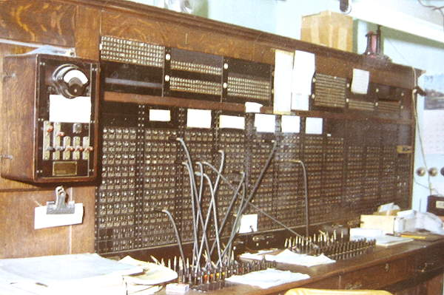
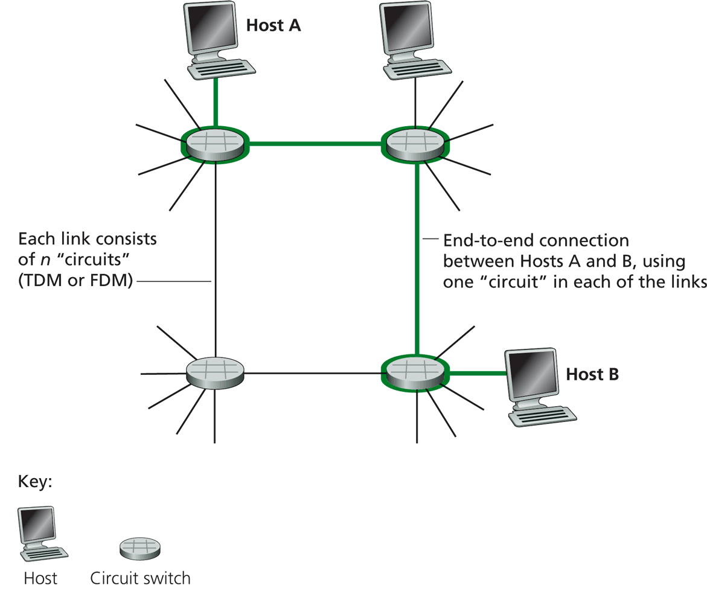
Circuit Switching
Each link has a number of “circuits”
sometime we refer to a “circuit” as a channel or a line
An end-to-end connection reserves one “circuit” at each link
First commercial telephone switchboard was opened in 1878 to serve the 21 telephone customers in New Haven
Notes:
http://www.classicrotaryphones.com/new-england-operators2_big.jpg

Slide 53
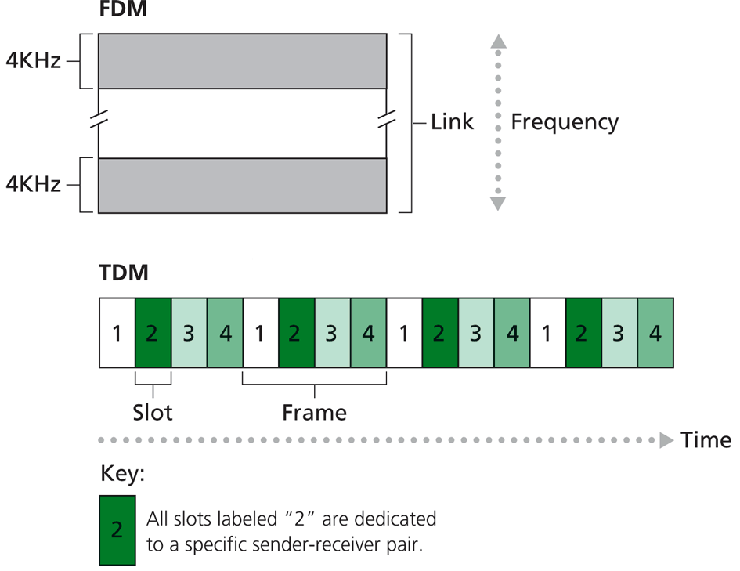
Circuit Switching: Resources/Circuits (Frequency, Time and others)
Divide link resource into “circuits”
frequency division multiplexing (FDM)
time division multiplexing (TDM)
others such as code division multiplexing (CDM), color/lambda division

Slide 54
Circuit Switching: The Process
Three phases
circuit establishment
data transfer
circuit termination

Slide 55
Timing Diagram of Circuit Switching
Host A
Host B
Node 1
Node 2
processing delay at Node 1
DATA
propagation delay
from A to Node 1
circuit establishment
propagation delay
from B To A
data transmission
circuit termination

Slide 56
Delay Calculation in Circuit Switched Networks
Propagation delay: delay for the first bit to go from a source to a destination
Propagation delay:
d = length of physical link
s = propagation speed in medium (~2x10⁵ km/sec)
prop. delay: d/s
DATA

Slide 57
Delay Calculation in Circuit Switched Networks
Transmission delay: time to pump data onto link at line rate
Transmission delay:
R = reserved bandwidth (bps)
L = message length (bits)
d/s
DATA
trans. delay = L/R

Slide 58
An Example
Propagation delay
suppose the distance between A and B is 4000 km, then one-way propagation delay is:
Transmission delay
suppose your iphone reserves a one-slot HSCSD channel
each HSCSD frame can transmit about 115 kbps
a frame is divided into 8 slots
then the transmission delay of using one reserved slot for a message of 1 Kbits:

Slide 59
An Example (cont.)
Suppose the setup message is very small, and the total setup processing delay is 200 ms
Then the delay to transfer a message of 1 Kbits from A to B (from the beginning until host receives last bit) is:
DATA
20 + 200
20
20
70

Slide 60
Outline
Admin. and recaps
A brief introduction to the Internet: past and present
Challenges of Internet networks and apps
A taxonomy of communication networks
circuit switched networks
packet switched networks

Slide 61
Packet Switching
Each end-to-end data flow (i.e., a sender-receiver pair) divided into packets
Packets have the following structure:
header and trailer carry control information (e.g., destination address, check sum)
where is the control information for circuit switching?
At each node the entire packet is received, processed (e.g., routing), stored briefly, and then forwarded to the next node; thus packet-switched networks are also called store-and-forward networks. On its turn, a packet uses full link bandwidth
Header
Data
Trailer

Slide 62
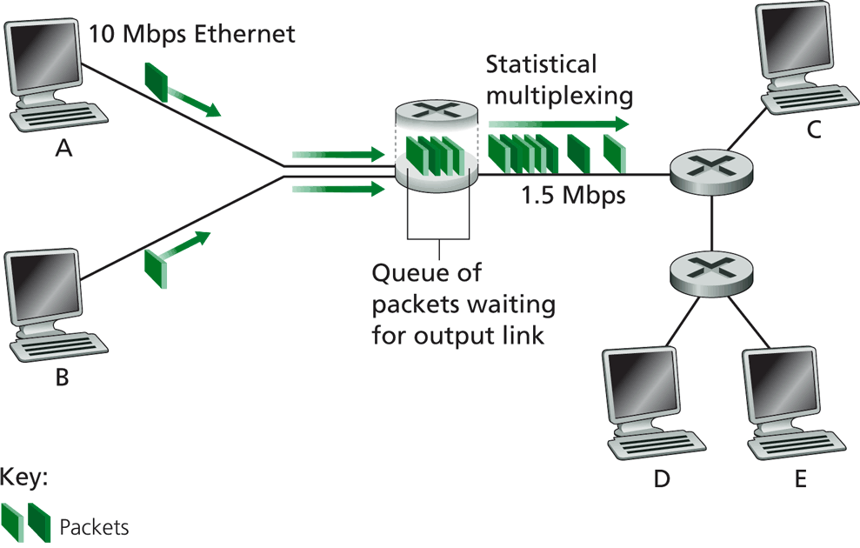
Packet Switching

Slide 63
Inside a Packet Switching Router
An output queueing switch
incoming links
node
outgoing links
Memory

Slide 64
Outline
Admin. and recaps
A brief introduction to the Internet: past and present
Challenges of Internet networks and apps
A taxonomy of communication networks
circuit switched networks
packet switched networks
circuit switching vs. packet switching

Slide 65

Packet Switching vs. Circuit Switching
The early history of the Internet was a heated debate between Packet Switching and Circuit Switching
the telephone network was the dominant network
Need to compare packet switching with circuit switching

Slide 66
Circuit Switching vs. Packet Switching
 | circuit switching | packet switching
resource usage | use a single partition bandwidth | use whole link bandwidth
reservation/setup | need reservation (setup delay) | no reservation
resource contention | busy signal (session loss) | congestion (long delay and packet losses)
charging | time | packet
header | no per-pkt header | per packet header
fast path processing | fast | per packet processing

Slide 67
Circuit Switching vs. Packet Switching
 | circuit switching | packet switching
resource usage | use a single partition bandwidth | use whole link bandwidth
reservation/setup | need reservation (setup delay) | no reservation
resource contention | busy signal (session loss) | congestion (long delay and packet losses)
charging | time | packet
header | no per-pkt header | per packet header
fast path processing | fast | per packet processing

Slide 68


Key Issue to be Settled
A key issue: what is the efficiency of resource partition?
Tool used to analyze the issue: queueing theory
Some basic results of queueing theory can be quite useful in many systems settings
5G
10G
5G
Notes:
10M bps link and 10 flows: partition into 10 1 Mbps or

Slide 69
Outline
Admin. and recaps
A brief introduction to the Internet: past and present
Challenges of Internet networks and apps
A taxonomy of communication networks
circuit switched networks
packet switched networks
circuit switching vs. packet switching
M/M queues and statistical multiplexing

Slide 70
Queueing Theory
Strategy:
model system state
if we know the fraction of time that the system spends at each state, we can get answers to many basic questions: how long does a new request need to wait before being served?
System state changes upon events:
introduce state transition diagram
focus on equilibrium: state trend neither growing nor shrinking (key issue: how to define equilibrium)
Our approach: We are not interested in extremely precise modeling, but want quantitative intuition

Slide 71
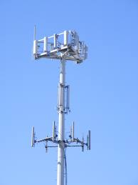
Warm up: Analysis of Circuit-Switching Blocking (Busy) Time
Assume a link has only a finite number of N circuits
Objective: compute the percentage of time that a new session (call) is blocked
Analogy in a more daily-life scenario?
Key parameters?
Notes:
Key input parameters?

Slide 72
Analysis of Circuit-Switching Blocking (Busy) Time
Consider a simple arrival pattern
client requests arrive at a rate of λ (lambda/second)
service rate: each call takes on average 1/μ second
Arrival and service patterns: memoryless (Markovian)
During a small interval Δt, the number of expected new arrivals is: λΔt
During a small interval Δt, the chance (fraction) of a current call finishes is: μΔt
This model is also called an M/M/N model

Slide 73
Analysis of Circuit-Switching Blocking (Busy) Time: State
system state: # of busy lines
0
1
k
k+1
N
p0
p1
pk
pk+1
pN
Q: How to characterize equilibrium?

Slide 74
Equilibrium = Time Reversibility [Frank Kelly]
Statistically cannot distinguish
state
k+1
k
time

Slide 75
Analysis of Circuit-Switching Blocking (Busy) Time: Sketch
system state: # of busy lines
λ
0
1
k
k+1
N
(k+1)μ
p0
p1
pk
pk+1
pN
at equilibrium (time resersibility) in one unit time: #(transitions k → k+1) = #(transitions k+1 → k)

Slide 76

Queueing Analysis: Packet Switching Delay
Four types of delay at each hop
nodal processing delay: check errors & routing
queueing: time waiting for its turn at output link
transmission delay: time to pump packet onto a link at link speed
propagation delay: router to router propagation
The focus is on queueing and transmission delay
system state?

Slide 77

Packet Switching Delay
system state: #packets in queue
λ
0
1
k
k+1
N
μ
p0
p1
pk
pk+1
at equilibrium (time reversibility) in one unit time: #(transitions k → k+1) = #(transitions k+1 → k)

